Slide 1
Configuration Management 1
SE489: DevOps Engineering

Slide 2
Outline
What is Configuration Management?
Before and After Configuration Management
Configuration Management Tools
What is Ansible?
Ansible Features
Ansible Case Study
Ansible for Orchestration, Provisioning, CM, AD, and Security

Slide 3
What is Configuration Management?

Slide 4
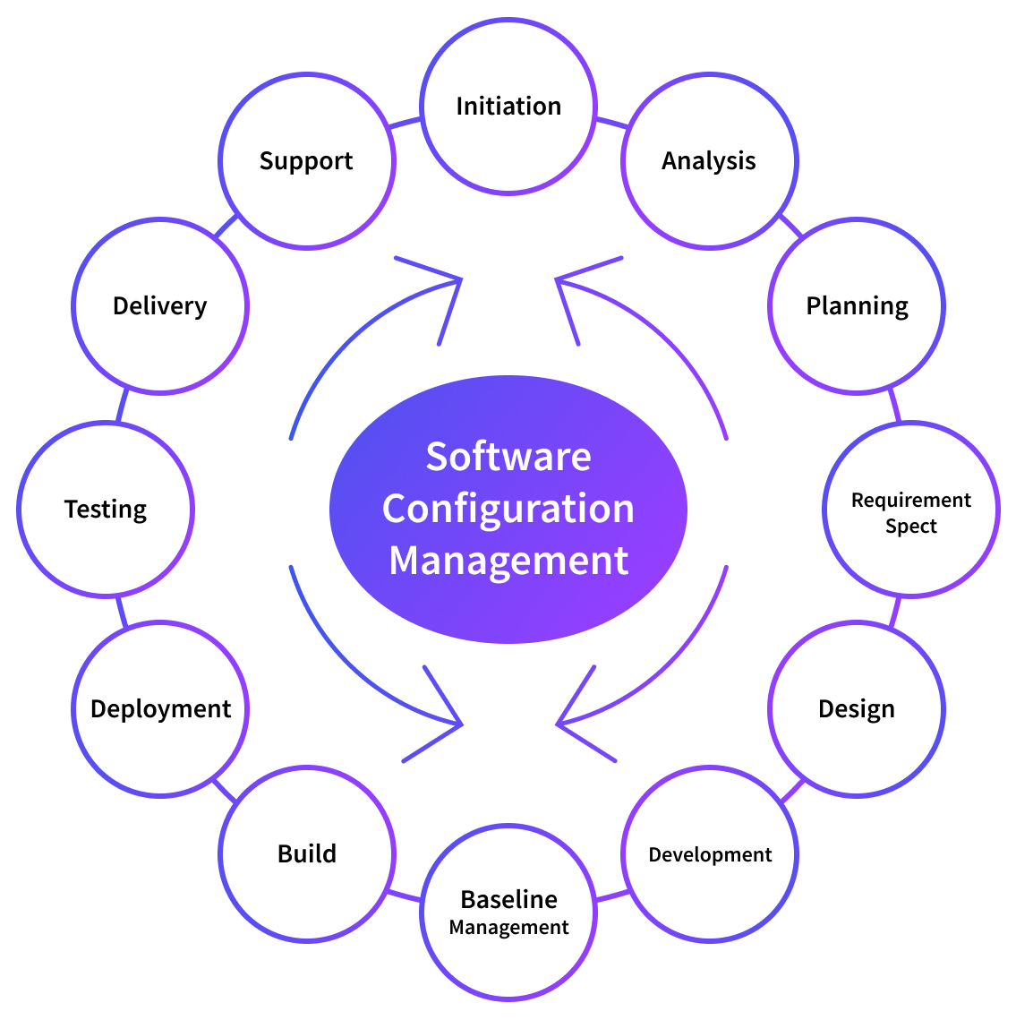
Configuration Management

Slide 5
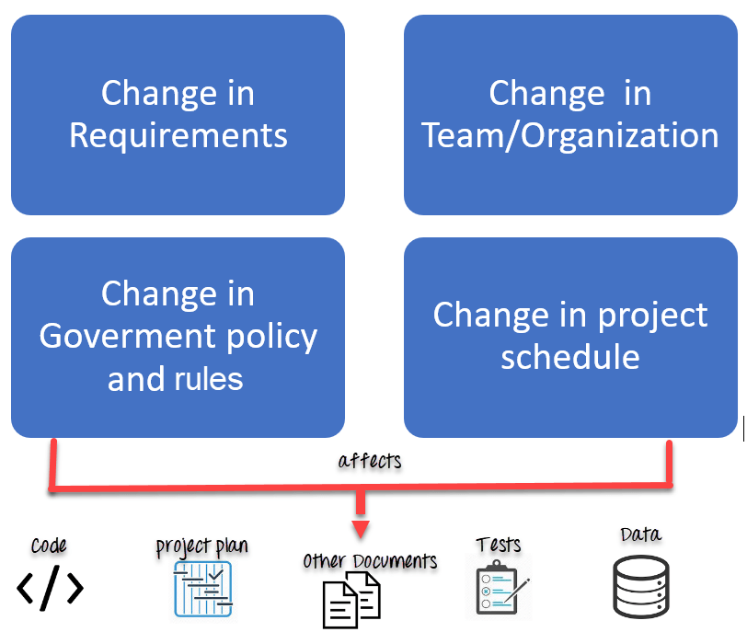
Configuration Management

Slide 6
What is Software Configuration Management?
Definition: Set of management disciplines within the software engineering process to develop and maintain the integrity of a baseline.
Description: SCM encompasses the disciplines and techniques of initiating, evaluating and controlling change to software products during and after the software engineering process.
Standards
IEEE 828: Software Configuration Management Plans
IEEE 1042: Guide to Software Configuration Management

Slide 7
SCM Basics
Identification – identifying software configuration items in a baseline
Control – controlling the release of a product and changes to it throughout its lifecycle
Status Accounting – recording and reporting of the status of components and changes
Auditing and Reviewing – Validating the completeness of a product and that SCM procedures are being followed

Slide 8
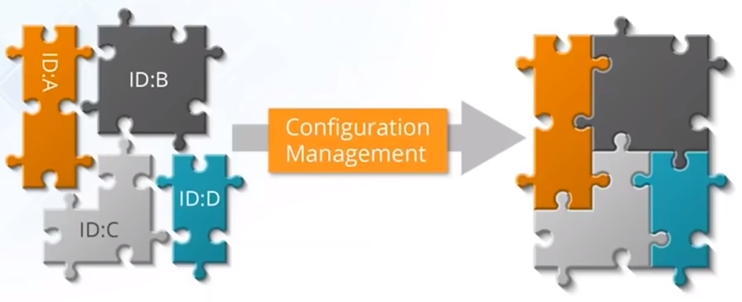
Configuration Management
Establish and maintain consistency of product performance
Maintain physical attributes with its requirements and design
Preserve operation information throughout its life

Slide 9
The benefits of a SCM Process
Multi-User Updates
Allow many people to work on development with constant updates and changes.
Productivity
Enhancing productivity by minimizing errors through matching environments.
Communication and Collaboration
Communication and collaboration are easy between team members.
Platform and OS Testing
Ensure that the software runs effectively across multiple platforms and operating systems.
Change Accommodation
SCM makes it easier to accommodate changes in schedule, policy, and users.
Cost Control
Tracking team members and project workflow which control costs and increase efficiency.

Slide 10
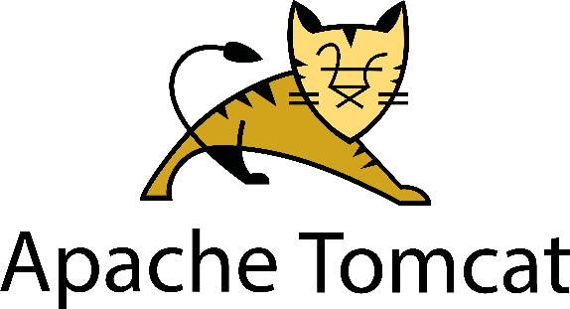
Configuration Management
Configuration management (CM) manages changes in the system or the server runtime environment.
Let's consider an example where we need to manage multiple servers with the same kind of configuration.
For example, we need to install Tomcat on each server.
What if we need to change the port on all servers, update some packages, or provide rights to some users?
Any kind of modification in this scenario is a manual and, if so, error-prone process.
As the same configuration is being used for all the servers, automation can be useful here.

Slide 11
Configuration Management
Configuration management is important in DevOps because
It helps you automate otherwise tedious tasks and allows an organization to increase agility.
It DevOps holistically, and it’s widely agreed upon that configuration management is essential to DevOps, as opposed to being just another component of the process.

Slide 12
Before and After Configuration Management

Slide 13



Before and After Configuration Management
Before
Problems in managing multiple servers
Application
Servers
After
Application
Application
Web Servers
DB Servers
App Servers
Servers
Servers

Slide 14

Before and After Configuration Management
Before
Scaling up of manual systems was a very tedious task
+
After
+

Slide 15



Before and After Configuration Management
Before
Code
Deploy
The work velocity of developers were affected since sysadmins were taking time to configure servers
Test Server
Prod Server
After
Code
Deploy
Code
Deploy
Test Server
Prod Server
Test Server
Prod Server

Slide 16
Before and After Configuration Management
Before
Upgrade
Rolling back was a problem since there was no tool to document the different versions of the application
Delete old version
Version 1
Version 2
Deploy new version
After
Upgrade
Upgrade
Delete old version
Delete old version
Version 1
Version 2
Version 1
Document old version
Version 2
Deploy new version
Deploy new version

Slide 17
Outcomes of Managed Configurations
Infrastructure-as-a-Code (IaaC)
IaaC in simplest terms is a code or script the automates the environment necessary for development, without manually completing all the steps necessary to build the environment.
Using the word ‘environment’ referrs to the set up of all computing resources required to create the infrastructure to perform DevOps actions. This could be servers, networks of configurations and other resources.
Configuration-as-a-Code (CaaC)
CaaC is a string of code or script that standardizes configurations within a given resource, like a server or network.
These configurations are applied during the deployment phase to ensure the configuration of the infrastructure makes sense for the application.

Slide 18
Benefits of IaaC and CaaC
These are some of the benefits of the two key outcomes:
Automation of the infrastructure environment provides standardization
Setups are free of human error
Collaboration is enhanced between operations and development
Keeps configurations from drifting
Makes infrastructure more flexible, ready to scale
Each step is consistent across all resources
Version control is a given
With these benefits applied to an organization, efficiency and greater agility are a natural result.
DevOps is practically synonymous with configuration management, IaaC, and CaaC.

Slide 19
Configuration Management Tools

Slide 20
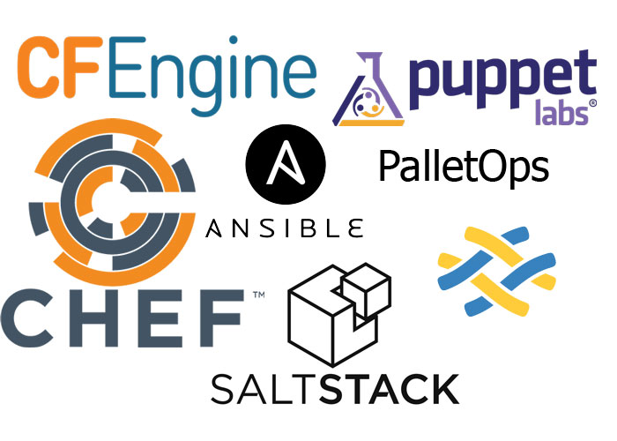
Configuration Management Tools

Slide 21
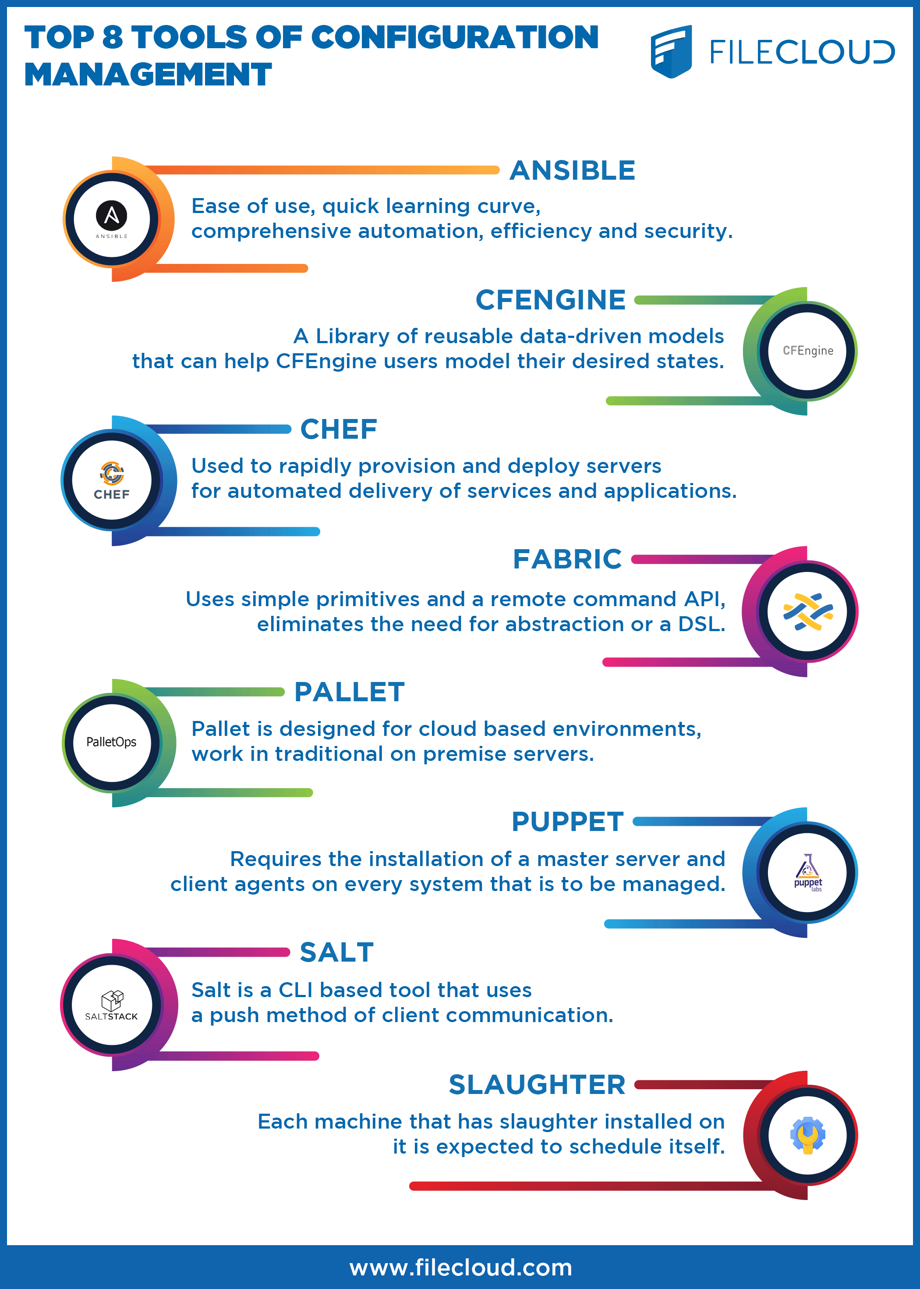

Slide 23
What is Ansible?

Slide 24
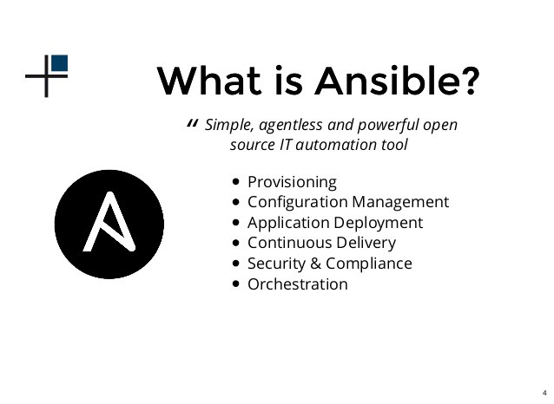
What is Ansible?

Slide 25

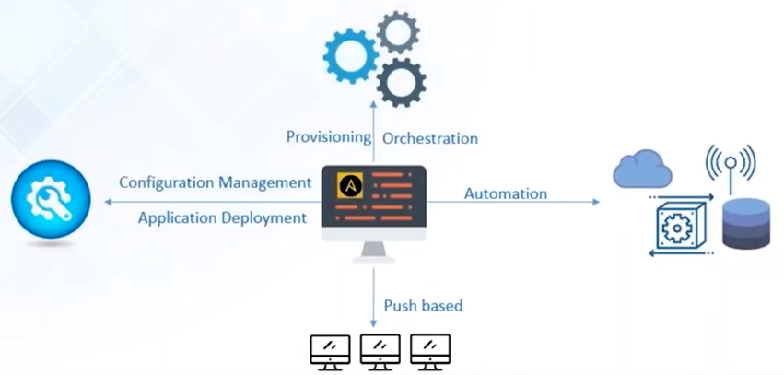
What is Ansible?
Ansible is a Configuration Management, Deployment, and Orchestration tool
It is a “push-based” Configuration Management tool
It automates your entire IT infrastructure by providing large productivity gain

Slide 26
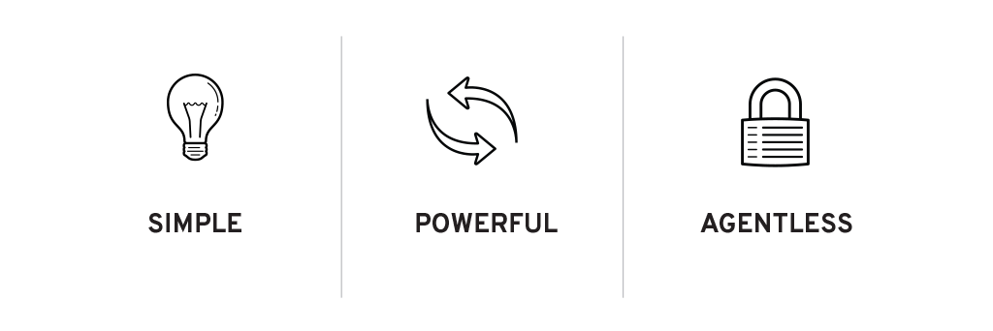
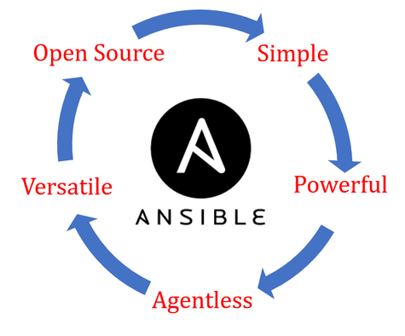

Ansible Features
Simple to install and setup and very easy to learn
No need for any agent or client software to manage nodes
Capabilities to model complex IT workflows and orchestrate your entire IT infrastructure
Extensible with modules written in any programming language
EFFICENT

Slide 27
Ansible Case Study

Slide 28
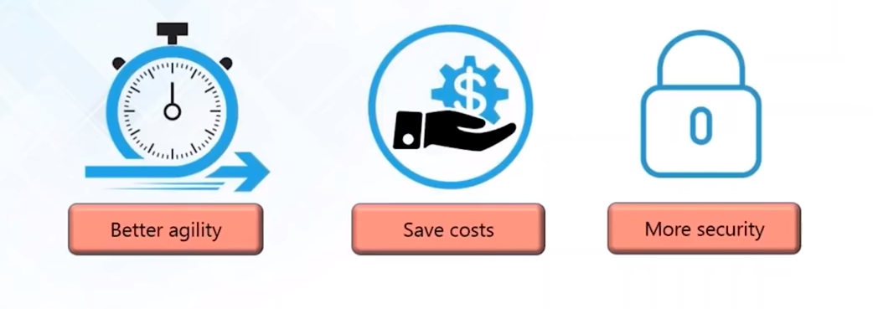

Ansible Case Study: NASA
NASA wanted to move 65 applications from traditional hardware based data centers to cloud based environment
What NASA wanted to achieve:

Slide 29
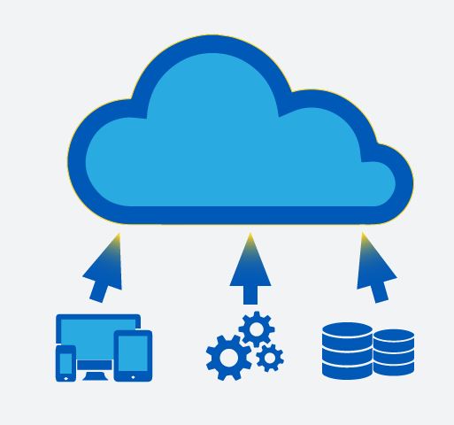
The problem …
Applications were migrated “as is” to cloud environment.
Environment spanning multiple VPCs and AWS accounts was created which couldn’t be easily managed
Managing access rights, security patching, and other simple tasks became tedious
Notes:
Virtual Private Cloud (VPC)

Slide 30
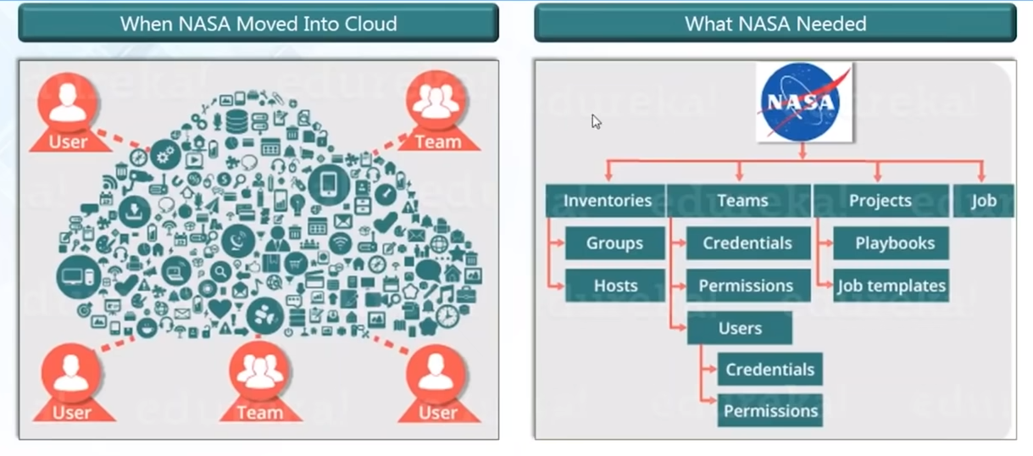
The problem …

Slide 31
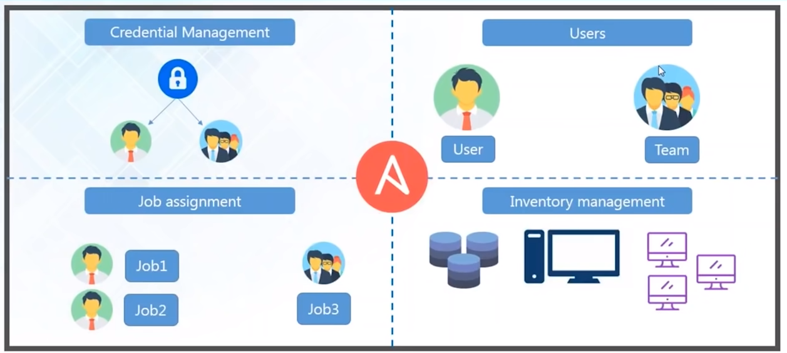
Ansible Tower to the rescue

Slide 32
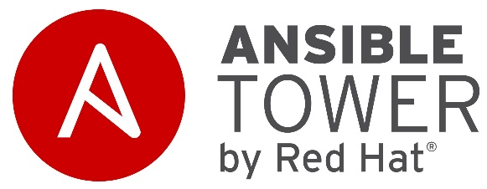
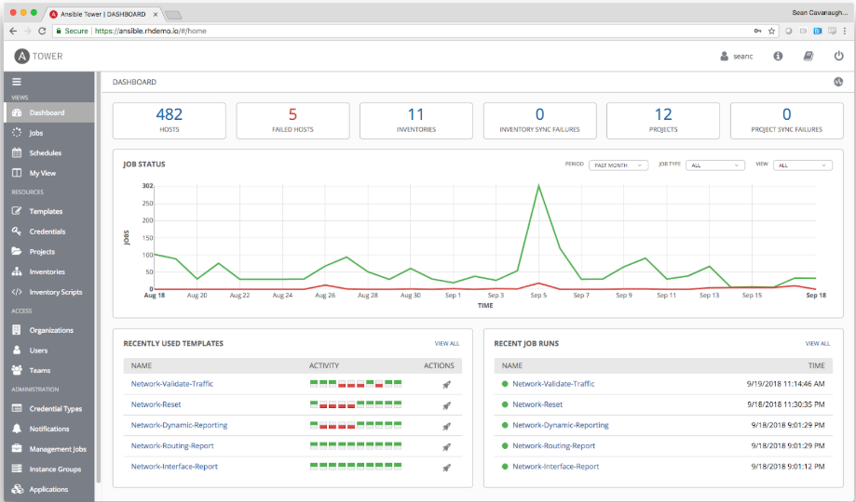
Ansible Tower Dahsboard
Provides status summary of all jobs
Divided organization into groups to manage access permissions

Slide 33
Results …
Updating nasa.gov went from 1 hour to 5 minutes
Security patching updates went from multi-day process to 45 minutes
Provisioning OS accounts across entire environment under 10 minutes
Application stacks set up time reduced from 1-2 hours to 10 minutes
Achieved near real-time RAM and disk-monitoring
Baselining standard AMIs from 1 hour manual process to invisible process
Notes:
Amazon Machine Images (AMI)

Slide 34
Ansible Architecture

Slide 35
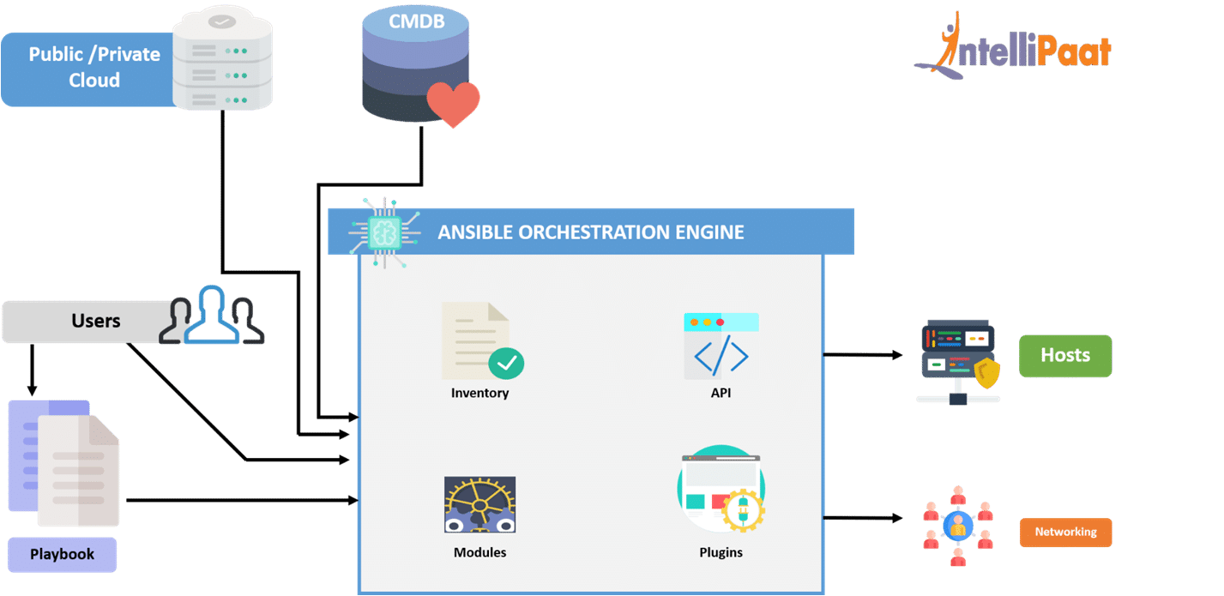
Ansible Architecture
Notes:
A CMDB is a database used to store IT configuration and infrastructure information.
The main purpose of a CMDB is to provide a single source of truth for an organization's IT service management (ITSM) initiatives, which can include hardware, software, systems, facilities, and even personnel.

Slide 36
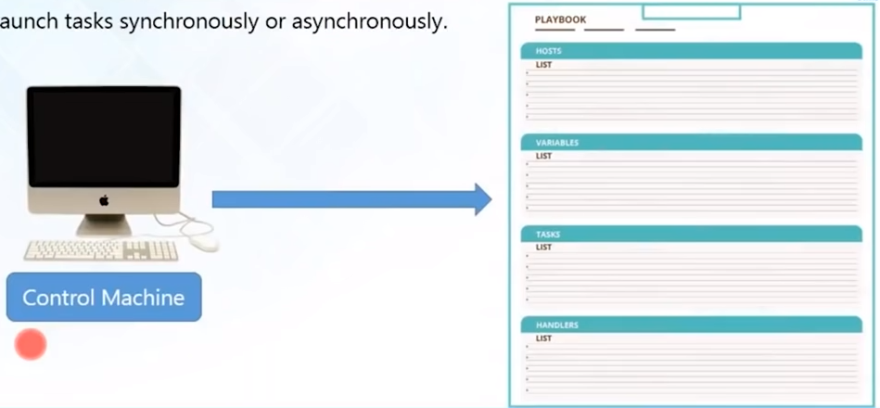
Ansible Playbook
Playbooks are simple files (YAML)
Declare configuration and orchestrate manual ordered processes
Launch tasks synchronously and a synchronously

Slide 37
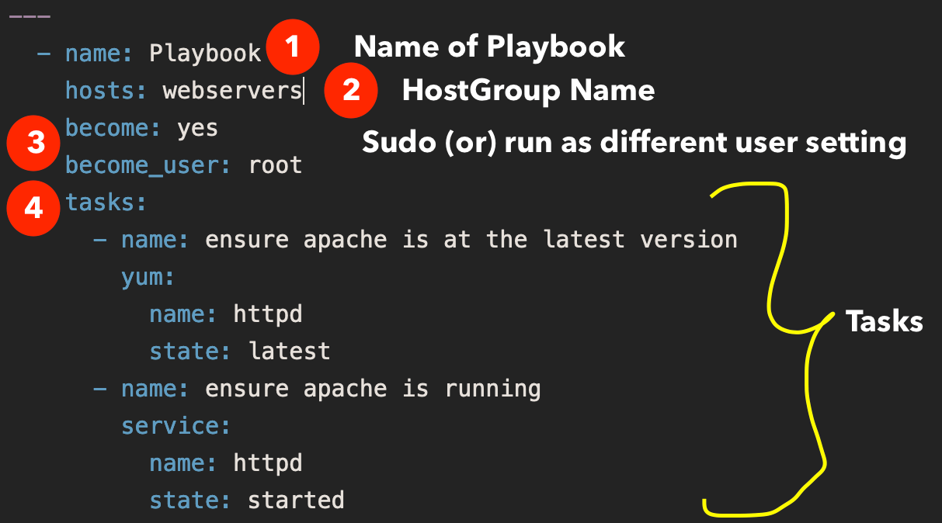
Ansible Playbook

Slide 38
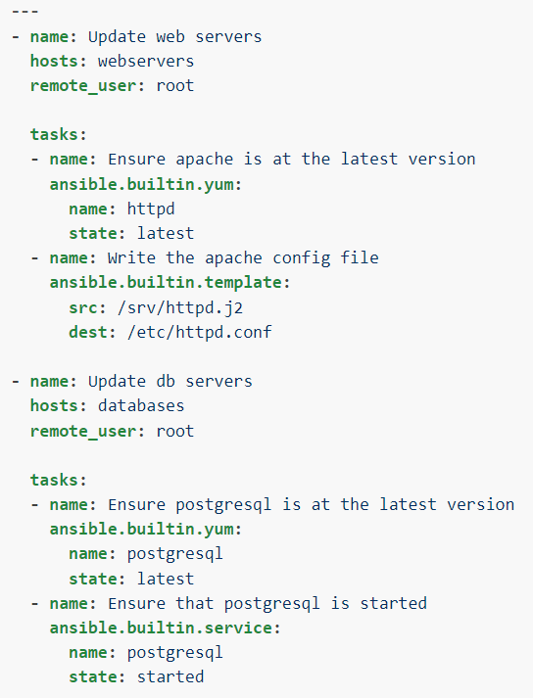
In this example,
the first play targets the web servers;
the second play targets the database servers.

Slide 39





How to use Ansible?
Application Deployment
Orchestration
Configuration Management
Provisioning
Security and Compliance

Slide 40
How to use Ansible?
Provision
Creation of resources. Resources can be server, files, folder, user, application etc.
Orchestration
Once the resources are created, ensuring that the same properties are applied to the newly created resources
Application Deployment
Deploy the code to the server
Configuration Management
Managing day to day activities like patching, rebooting, updating resources etc.int he specific group of servers.

Slide 41
Application Deployment
Using Ansible, you can quickly and easily deploy multitier apps.
You won’t need to write custom code to automate your systems; you list the tasks required to be done by writing a playbook, and Ansible will figure out how to get your systems to the state you want them to be in.
In other words, you won’t have to configure the applications on every machine manually.
When you run a playbook from your control machine, Ansible uses SSH to communicate with the remote hosts and run all the commands (tasks).

Slide 42
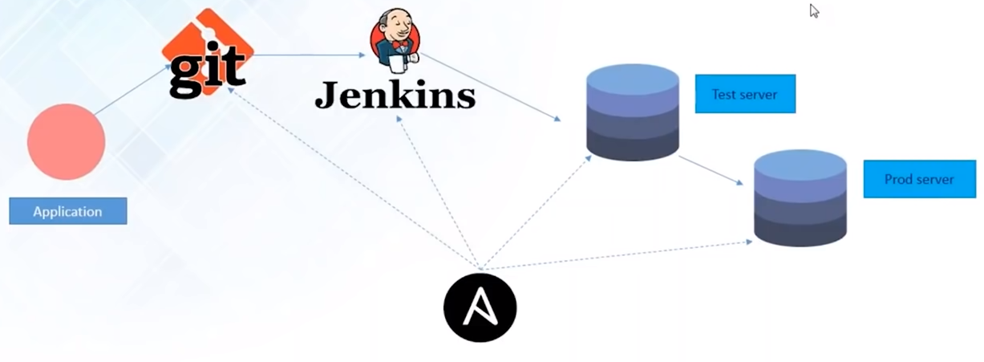
Application Deployment

Slide 43
Orchestration
Orchestration involves bringing different elements into a beautifully run whole operation—similar to the way a musical conductor brings the notes produced by all the different instruments into a cohesive artistic work.
For example, with application deployment, you need to manage not just the front-end and backend services but the databases, networks, storage, and so on.
You also need to make sure that all the tasks are handled in the proper order.

Slide 44
Orchestration
Ansible uses automated workflows, provisioning, and more to make orchestrating tasks easy.
And once you’ve defined your infrastructure using the Ansible playbooks, you can use that same orchestration wherever you need to, thanks to the portability of Ansible playbooks.

Slide 45
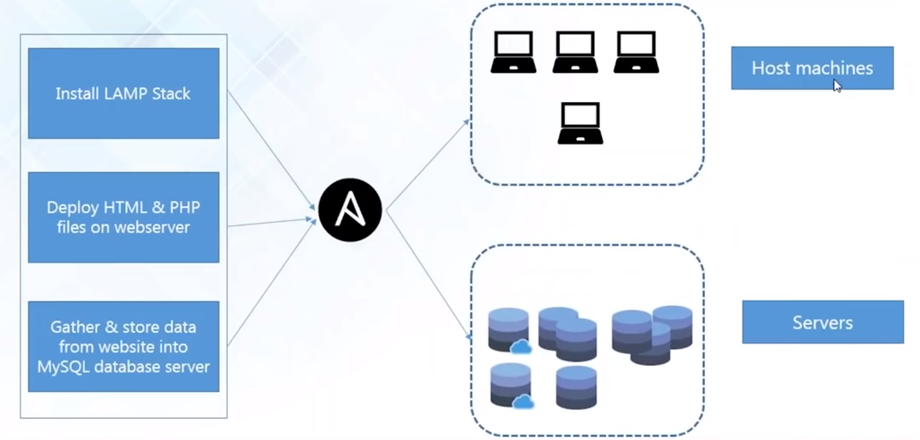
Orchestration

Slide 46
Configuration Management
Ansible is designed to be very simple, reliable, and consistent for configuration management.
Ansible configurations are simple data descriptions of infrastructure and are both readable by humans and parsable by machines.
All you need to start managing systems is a password or an SSH (Secure Socket Shell, a network protocol) key.
For example, If you want to install an updated version of a specific type of software on all the machines in your enterprise, all you have to do is write out all the IP addresses of the remote hosts and write an Ansible playbook to install it on all of them.

Slide 47
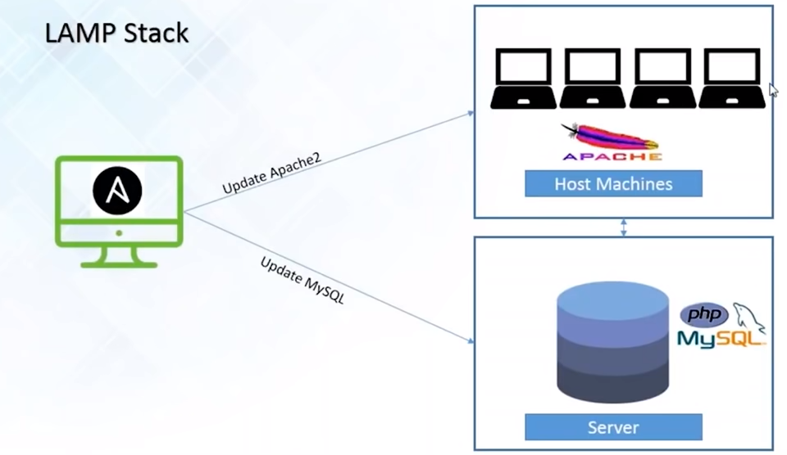
Configuration Management

Slide 48
Provisioning
The first step in automating your applications’ life cycle is automating the provisioning of your infrastructure.
With Ansible, you can provision cloud platforms, virtualized hosts, network devices, and bare-metal servers.

Slide 49
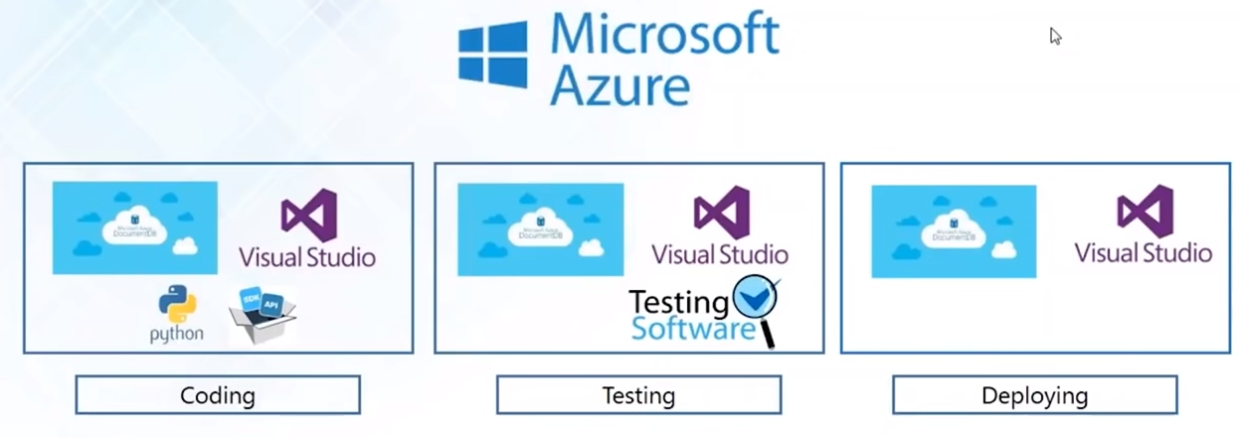
Provisioning
Provisioning of Python web application hosted on Azure

Slide 50
Security and Compliance
As with application deployment, sitewide security policies (such as firewall rules or locking down users) can be implemented along with other automated processes.
If you configure the security details on the control machine and run the associated playbook, all the remote hosts will automatically be updated with those details.
That means you won’t need to monitor each machine for security compliance continually manually.
And for extra security, an admin’s user ID and password aren’t retrievable in plain text on Ansible.

Slide 51
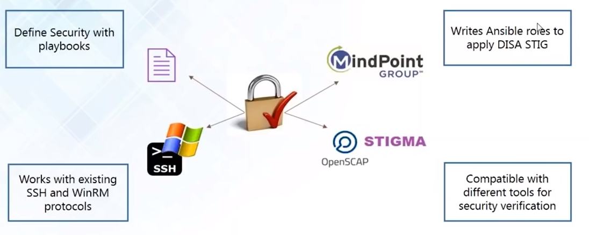
Security and Compliance

